Slide 1

Engineering
Economics
Lecture-5

Slide 2
Elasticity
Elasticity is a measure of how much buyers and sellers respond to changes in market conditions.
It allows us to analyze supply and demand with greater precision.
There are three types of elasticity of demand.
Price elasticity.
Income elasticity.
Cross elasticity.
Notes:
2
2

Slide 3
Price Elasticity of Demand
Price Elasticity of Demand (PED) is defined as the responsiveness of quantity demanded to a change in price.
Demand is said to be elastic when the change in demand is proportionally larger than the change in price. In other words, demand is elastic when the demand changes significantly with smaller price changes.
Conversely, demand is inelastic when the change in demand is proportionally smaller than the difference in price.

Slide 4
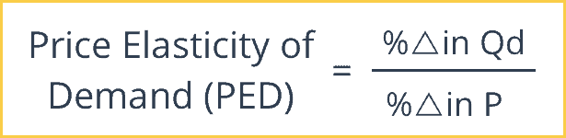
Price Elasticity of Demand

Slide 5
Price Elasticity of Demand
%∆ in Q_{d} = Percentage Change in Quantity Demanded. The Percentage Change in Quantity Demanded is the New Quantity Demanded minus the Old Quantity Demanded divided by the Old Quantity Demanded.
%∆ in P = Percentage Change in Price. This is the New Price minus the Old Price divided by the Old Price.

Slide 6
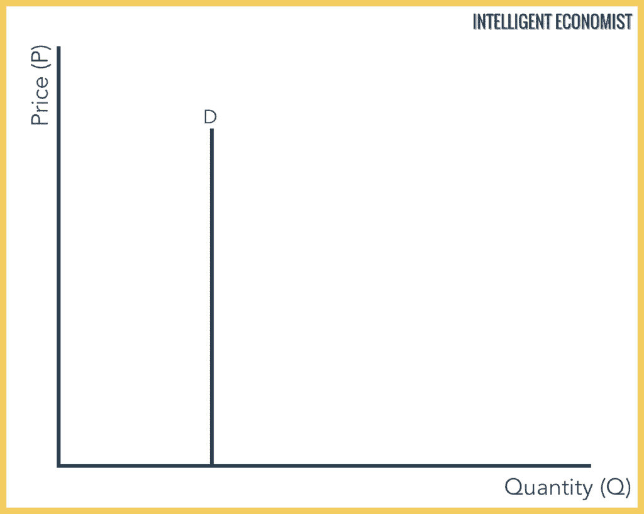
Perfectly Inelastic Demand, (PED = 0)

Slide 7
Perfectly Inelastic Demand, (PED = 0)
With a perfectly inelastic demand, there is no change in the demand for a product with a change in its price. This means that the demand remains constant for any value of price. The demand curve is represented as a straight vertical line.
It is practically impossible to find a product that has a perfectly inelastic demand. The closest thing could be essentials like water or certain food products.

Slide 8
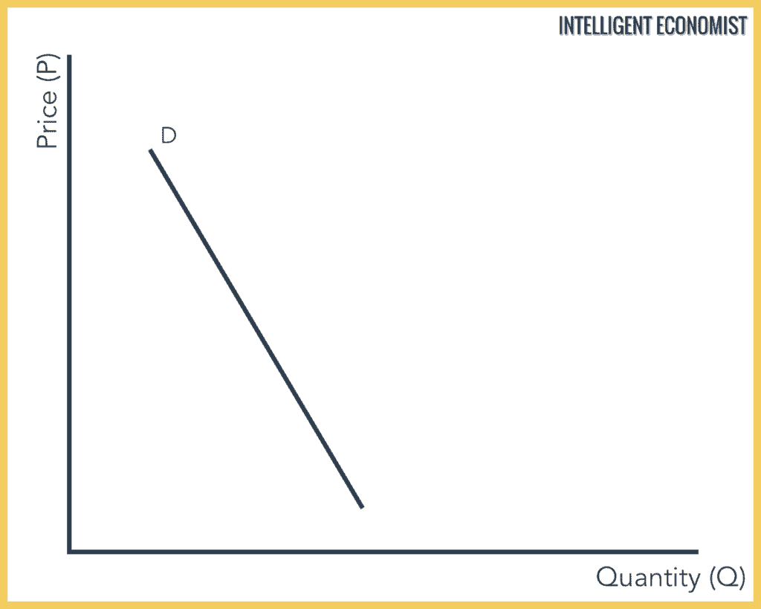
Relatively Inelastic Demand, (PED = 0 < x < 1)

Slide 9
Relatively Inelastic Demand, (PED = 0 < x < 1)
Relatively inelastic demand occurs when the percentage change in demand is less than the percentage change in the price of a product.
For example, if the price of a product increases by 15% and the demand for the product decreases only by 7%, then the demand would be called relatively inelastic.

Slide 10
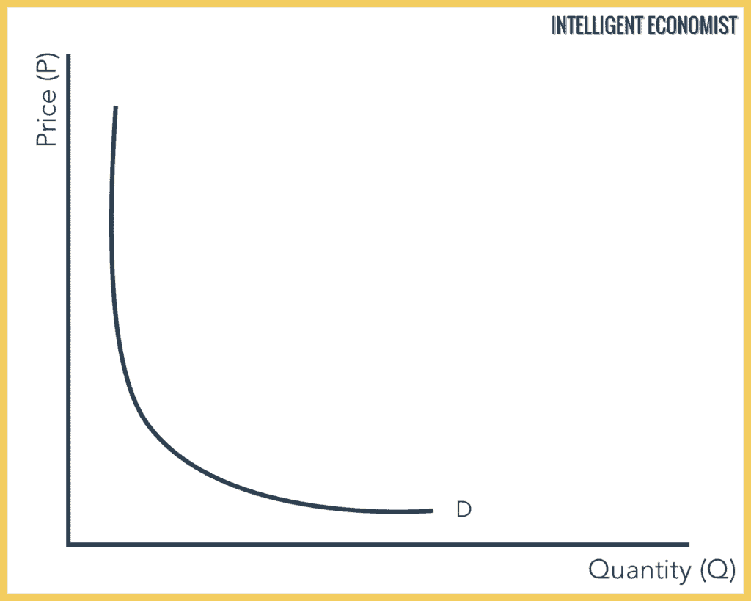
Unit Elastic Demand, (PED = 1)

Slide 11
Unit Elastic Demand, (PED = 1)
Demand is said to be unit elastic when the proportionate change in demand produces the same change in the price. The quantity demanded changes by the same percentage as the change in price.

Slide 12
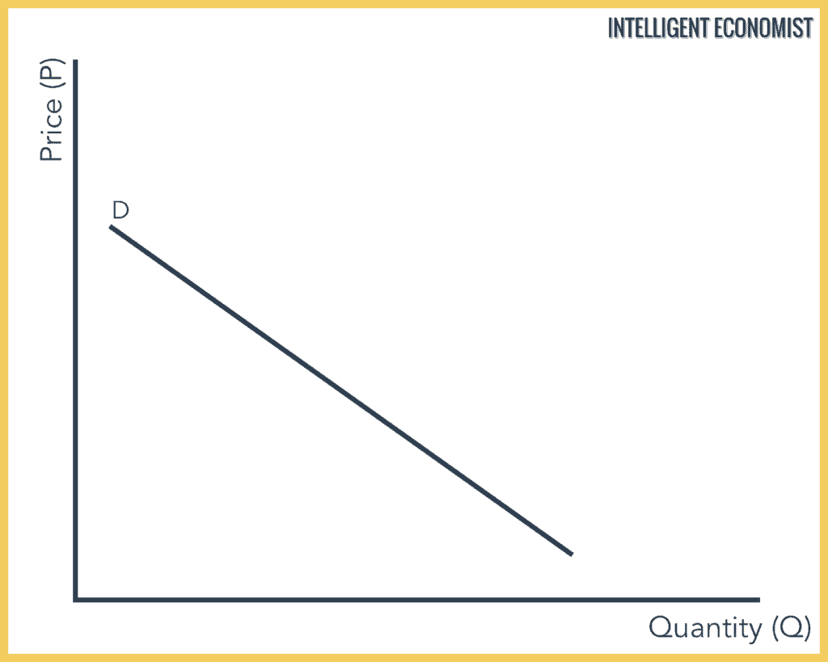
Relatively Elastic Demand, (PED = 1 < x < ∞)

Slide 13
Relatively Elastic Demand, (PED = 1 < x < ∞)
Relatively elastic demand is defined as the proportionate change produced in demand is greater than the proportionate change in the price of a product. The quantity demanded changes by a larger percentage than the change in price.
For example, if the price of a product increases by 10% and then the demand for the product decreases by 15%, then the demand would be relatively elastic.

Slide 14
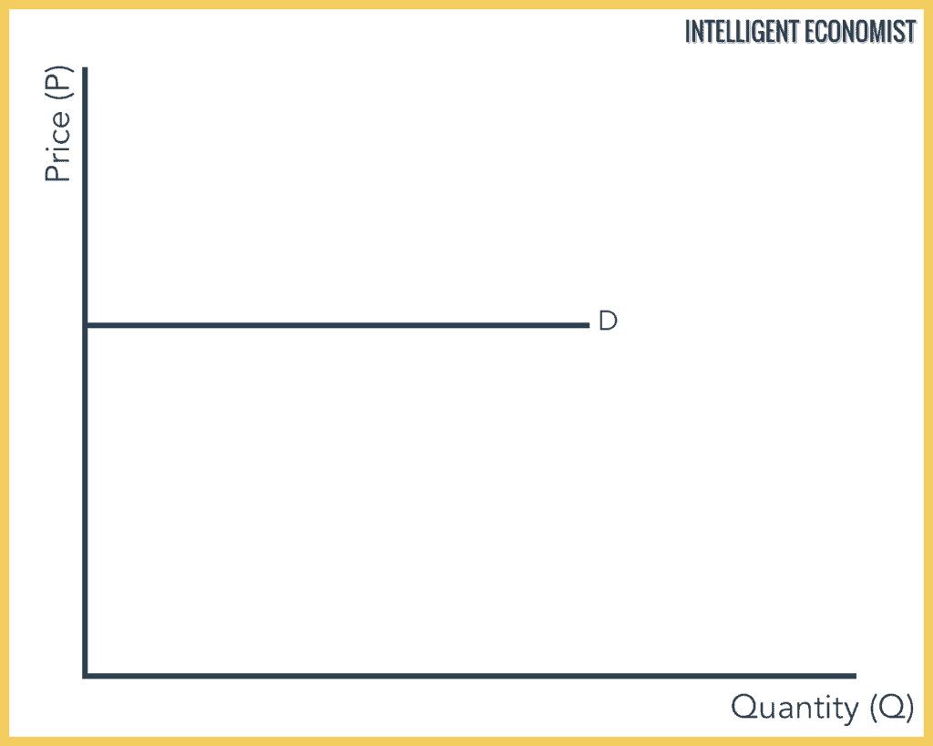
Perfectly Elastic Demand, (PED = ∞)

Slide 15
Perfectly Elastic Demand, (PED = ∞)
In Perfectly Elastic Demand, a small rise in price will result in a fall in demand to zero, while a small fall in price will result in the demand to become infinite.
This is a theoretical concept because it requires perfect competition where the slightest price increase results in zero demand.
In a perfectly elastic demand, the demand curve is represented as a horizontal straight line.

Slide 16
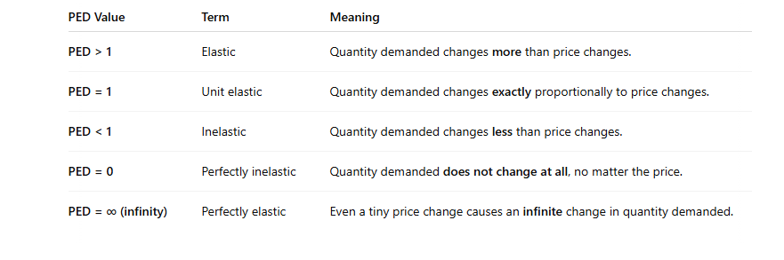
Range of Price elasticity

Slide 17
Math on Price elasticity
When the price of CD increased from $20 to $22, the quantity of CDs demanded decreased from 100 to 87.What is the price elasticity of demand for CDs?
The price increases from $20 to $22. Therefore % change in price = (22-20/20)*100 = 10
0.1 = 10% (0.1 *100)
Quantity fell by (87-100/100)*100 =13
Therefore PED = -13/10
Therefore PED = -1.3. Therefore Demand is elastic. Elastic demand occurs when % change in quantity is greater than % change in price; when PED >1.

Slide 18
Math on Price elasticity
Mathematically, PED is negative because of the law of demand (price and quantity demanded move in opposite directions).
But in economics, we often care about the magnitude of responsiveness, not the direction.
So we ignore the negative sign and report PED as a positive number. Suppose PED = −2.5 (meaning a 1% price increase leads to a 2.5% decrease in quantity demanded).We report it simply as 2.5 when talking about "elasticity“.

Slide 19
Income Elasticity of Demand
Income elasticity of demand measures how much the quantity demanded of a good responds to a change in consumers’ income.
It is computed as the percentage change in the quantity demanded divided by the percentage change in income.
Notes:
29
19

Slide 20
Computing Income Elasticity
Percentage Change
in Quantity Demanded
Income Elasticity
of Demand
=
Percentage Change
in Income
Notes:
31
20

Slide 21
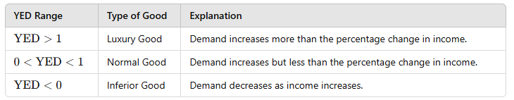
Income Elasticity
- Types of Goods -
Notes:
32
21

Slide 22
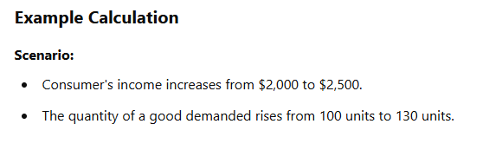
Income Elasticity
- Types of Goods -
Notes:
32
21

Slide 23
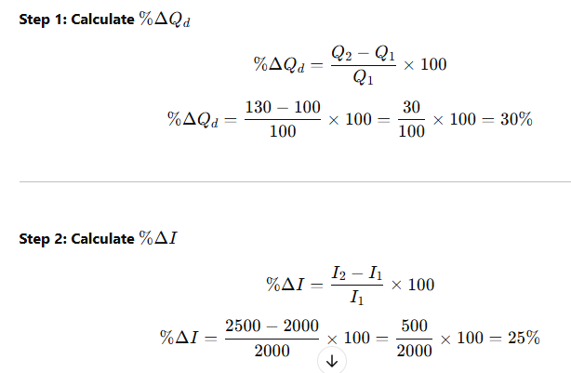
Income Elasticity
- Types of Goods -
Notes:
32
21

Slide 24
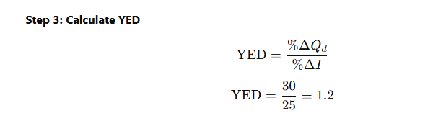
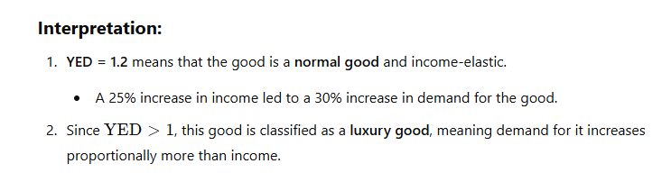
Income Elasticity
- Types of Goods -
Notes:
32
21

Slide 25
Cross Price Elasticity of Demand
Cross Elasticity of Demand measures how the quantity demanded of one good changes in response to a change in the price of another related good. It indicates whether the two goods are substitutes, complements, or independent.
By calculating cross price elasticity, it can be determined if the products are substitutes, complements, or are not related to each other.
In such a situation, if the products are substitutes of each other, then a positive cross elasticity of demand is observed, while if the products are complements of each other, then a negative cross elasticity of demand is observed.

Slide 26
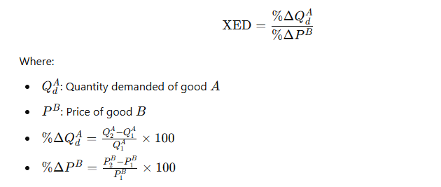
Cross Price Elasticity of Demand

Slide 27
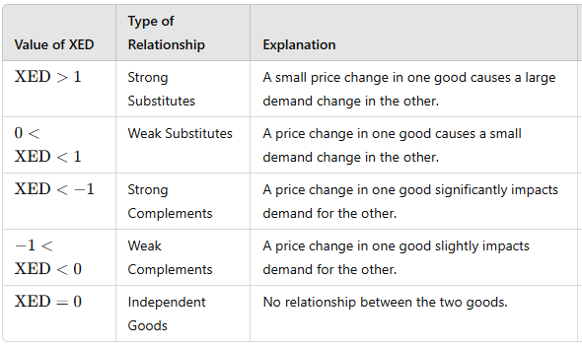
Cross Price Elasticity of Demand

Slide 28
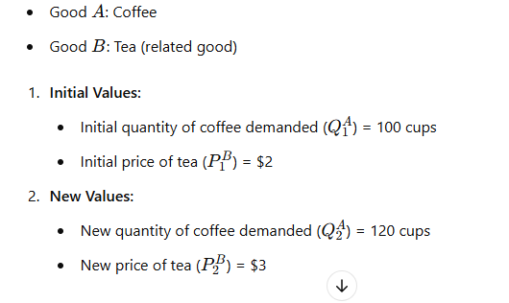
Cross Price Elasticity of Demand

Slide 29
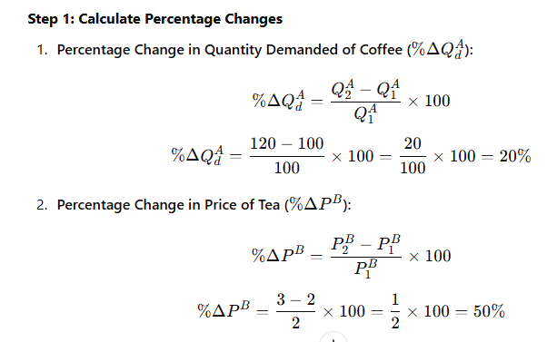
Cross Price Elasticity of Demand

Slide 30
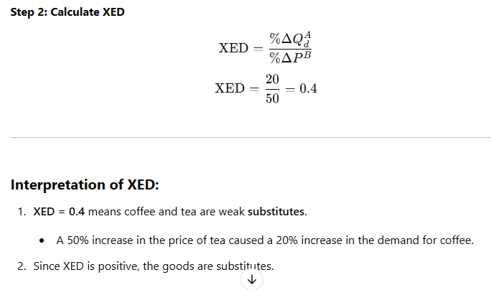
Cross Price Elasticity of Demand

Slide 31
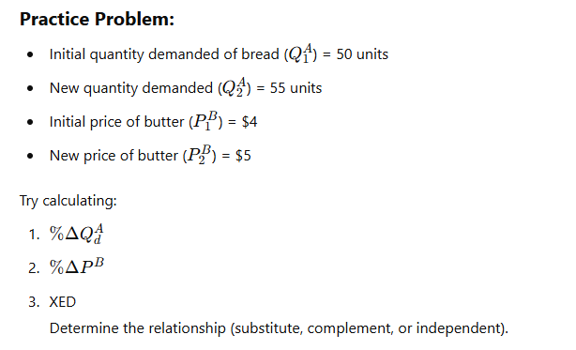
Cross Price Elasticity of Demand

Slide 32
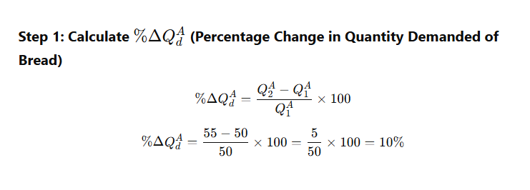
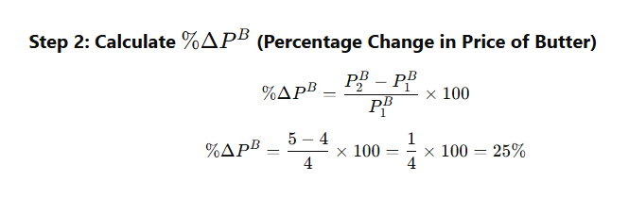
Cross Price Elasticity of Demand

Slide 33
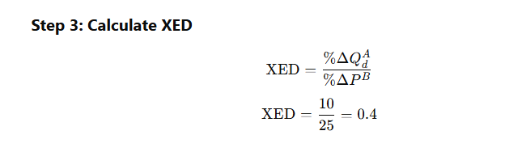
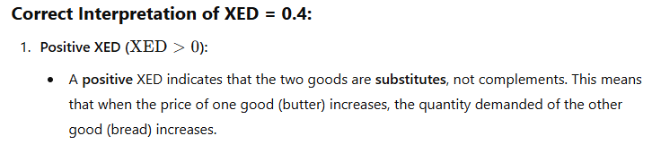
Cross Price Elasticity of Demand

